Slide 1
Wednesday , September 29th , 2021
Unit 2 : CLOTHING
LESSON : GETTING STARTED + LISTEN AND READ

Slide 2
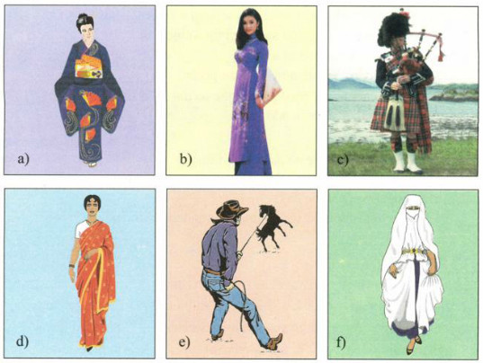
JAPAN - KIMONO
VIETNAM- AO DAI
KILT - SCOTLAND
INDIA- SARI
UNITED STATES – SHIRT AND JEAN
ISLAMIC COUNTRY-VEIL

Slide 3
I. NEW WORDS :
- poet/ poem/ poetry (n.)
- majority (n.)
major (a.)
- mention (v.)
- tunic (n.)
- unique (a.) uniquely (adv.)
uniqueness (n.)
- slit (n.)
slit/ slit/ slit (v.)
- symbol (n.)
symbolize (v.)
- inspiration (n.)
inspirational (a.)
inspire (v.)
take inspiration from
- alternative (n.)
alternative (a.)
- minority (n.) (ies. pl.) minor (a.)
ethnic minority (n.)
- pattern (n.)
- loose(a.) >< tight
loosen (v.)

Slide 4
A | B
1.symbol | a) the larger number or part of something
2.designer | b) a sign, shape, or object that is used to represent something
3.slit | c) not modern
4.convenient | d) a person who imagines how something could be made
5.old- fashioned | e) not firmly fixed in place/ not tight
6.loose | f) a smaller number or part
7.majority | g) make a long, straight, narrow cut in something
8.minority | h) comfortable, serviceable
Answers: 1 2. 3. 4. 5. 6. 7. 8.
b
d
g
h
c
e
a
f

Slide 5

For centuries, poets, writers and musicians have mentioned the ao dai in poems, novels and songs. The ao dai is the traditional dress of Vietnamese women. It consists of a long silk tunic that is slit on the sides and worn over loose pants. Traditionally, it was frequently worn by both men and women. The design and material used for men were different from those used for women. Nowadays, women usually wear it, especially on special occasions. However, many Vietnamese women today often prefer to wear modern clothing at work, because it is more convenient.
Now fashion designers want to change the traditional ao dai. Some have printed lines of poetry on the ao dai, so they look modern and very fashionable. Other designers have taken inspiration from Vietnam’s ethnic minorities.
They have visited villages and studied traditional designs and symbols such as suns, stars, crosses, and stripes. They have added these patterns to the ao dai, so Vietnamese women can continue to wear the unique dress, which is now both traditional and fashionable.

Slide 6
TRUE OR FALSE
1. The ao dai has been mentioned in poems, novels and songs for a long time. _________
2. The design and material used for men and women weren’t the same. _________
3. The majority of Vietnamese women prefer to wear ao dai at work. __________
4. Fashion designers don’t know how to modernize the ao dai. __________
5. Nowadays, not only women but also men wear the ao dai on special occasions. _______
T
T
F
F
F

Slide 7
Complete the sentences.
1. For a long time the ao dai has been the subject of
_____________________________________________
2. The ao dai is described as a
_____________________________________________
3. The majority of Vietnamese women prefer
_____________________________________________
4. Some designers have modernized the ao dai by printing
_____________________________________________
5. Another alternative is to add
_____________________________________________
poems, novels and songs.
long silk tunic with slits up the sides worn over loose pants.
to wear modern clothing at work.
printing lines of poetry on it.
symbols such as suns, stars, crosses and stripes.

Slide 8
Answer the questions.
1.Who used to wear the ao dai by tradition?
________________________________________________
2.Why do the majority of Vietnamese women prefer to wear
modem clothing at work these days?
________________________________________________
3.What have fashion designers done to modernize the ao dai?
_______________________________________________
both men and women
because it is more convenient.
have printed lines of poetry on the ao dai, or have added
symbols such as suns, stars, crosses and stripes
to the ao dai.

Slide 9
II. GRAMMAR
The present perfect tense :
( + )S + have / has + V- ed / -3
( - ) S + have / has + not + V- ed / -3
( ? ) Have / Has + S + V- ed / -3 ….?
Cách dùng:
Hành động vừa mới xảy ra trong quá khứ Ex: I have just finished my homework
Hành động hay sự việc xảy ra trong quá khứ nhưng không nhớ rõ time Ex: I have already seen that film
Hành động xảy ra trong quá khứ vẫn kéo dài tới hiện tại EX: She has studied French for three years
Từ nhận biết: Just, already, yet, ever, so far, recently, lately, before, up to now, since, for , never
Since + a point of time ( mốc time ) (Since 2011, Since January,…… )
For + a period of time ( khoảng time) ( For 5 years )

Slide 10
III . HOMEWORK
Write Voc and grammar in your note book
and learn by heart .
Do exercises + study Lesson : Listen ( K12 )
Prepare Unit 2 : Read

